Slide 1
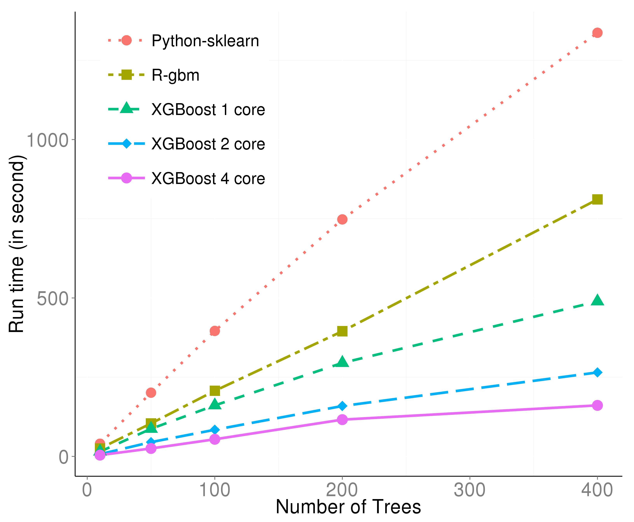
XGBoost
Noah Barcomb
This Photo by Unknown Author is licensed under CC BY

Slide 2
Why XGBoost?
XGBoost is much more complex than a simple linear regression model.
Does not need feature engineering
Real estate pricing analysis is complex, affected by multiple factors
Efficient

Slide 3
How does XGBoost Work?
XGBoost uses trees that learn from the errors of the previous ones.
Combines all of these tree “branches” into one main large prediction/model.
Captures the relevance/interaction between features and lets you know the correlation if any between them.

Slide 4
What is XGBoost Good For?
XGBoost is good for complex datasets that span over millions of rows.
It is optimized for speed and performance.
Real estate prediction, fraud prevention, credit risks assessments.

Slide 5
What is XGBoost Not Good For?
XGBoost does not handle smaller datasets as well as larger.
It is designed for tabular data, no audio/images, etc.
Embedded environments where resources are limited like processing power.
Real-time predictions requiring low-overhead.
Does not handle categorical features natively, requires OneHotEncoding.

Slide 6
What is XGBoost Not Good For?
Prone to overfitting when data has irrelevant features, especially with complex datasets.
Interpretability

Slide 7

XGBoost Math
This function consists of 2 pieces, the Loss Function (measurement of how well the function is doing with the model) & the Regularization Term (avoids overfitting).
n = the number of training examples
yi​ = true value of the i-th data point
y^​i​ = predicted value for the i-th data point
fk​ = the k-th tree in the ensemble
T = total number of trees

Slide 8




XGBoost Math Additive Model
Builds decision trees by adding one tree at a time to the model. At step t, the prediction is the algorithm below where:
Is the predicted value after the t-th iteration
Is the predicted value from the previous iteration
Output of the t-th tree for the i-th data point.

Slide 9



XGBoost Math
XGBoost minimizes the objective function using Taylor Expansion.
Where:
Gradient of the loss function aka the first derivative
Where:
Hessian of the loss function aka the second derivative

Slide 10

XGBoost Math
Since XGBoost uses trees, leaf nodes are present and a prediction is made.
Where:
gi​ = the gradients for the examples in the leaf
hi = the hessians for the examples in the leaf
Λ = regularization parameter

Slide 11

XGBoost Math Final Prediction
Where T is the total number of trees

